Slide 1
BANKINGMANAGEMENT SYSTEM

Slide 2
Under the Guidance of ,
Mrs. Indrakka Malli
Submitted BY,
Sreeja
Suma M R
Prashanth
Sudha R
Kushal
Goutham

Slide 3
Introduction
The bank management system is an application for maintaining a person’s account in a bank. The system provides the access to the customer to create an account, deposit/withdraw the cash from his account, also to view reports of all accounts present. The following presentation provides the specification for the system.

Slide 4
Modules:
Account
Customer
Deposit
Withdraw
Transfer

Slide 5
Software Requirements
Spring boot
Rest API
MySql
Postman
Hardware Requirement
Windows 10 or above
RAM :4GB or above

Slide 6
Annotations:
1.@Entity
2.@Id
3.@GeneratedValue
4.@RestController :
It can be considered as combination of @Conttoller
and @ResponseBody annotations.
5.@Autowired
: Spring provides annotation-based auto-wiring by providing @Autowired annotation. It is used to autowire spring bean on setter methods, instance variable, and constructor.

Slide 7
6.@GetMapping
: It maps the HTTP GET requests on the specific handler method. It is used to
create a web service endpoint that fetches
7.@PutMapping
: It maps the HTTP PUT requests on the specific handler method. It is used to create a web service endpoint that creates or updates
8.@DeleteMapping
: It maps the HTTP DELETE requests on the specific handler method. It is used
to create a web service endpoint that deletes a resource.
9.@PostMapping
: It maps the HTTP POST requests on the specific handler method. It is
used to create a web service endpoint that creates
10.@Repository :
10.@Query

Slide 8
11.@Transactional:
12.@Modifying :
13.@Service
:It is used at class level. It tells the spring that class contains the business logic
14.@RequestBody
:It is used to bind HTTP request with an object in a method parameter.
15.@PathVariable:
16.@NotBlank:
17.@ResponseStatus :
18.@ExceptionHandler:

Slide 9
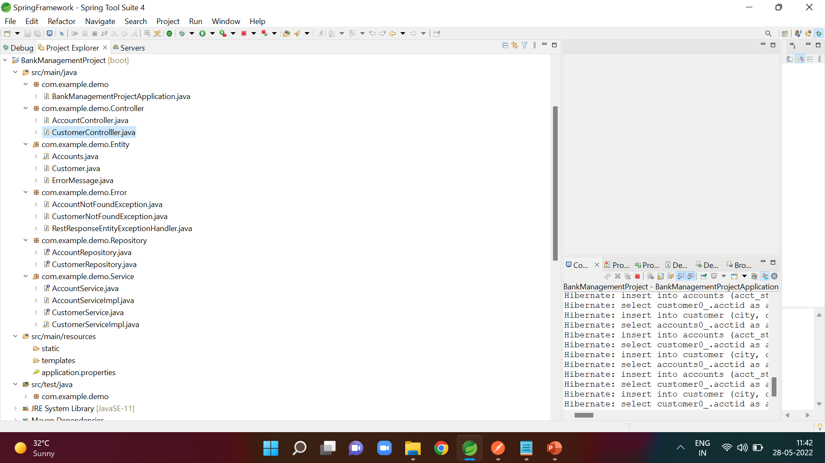

Slide 10
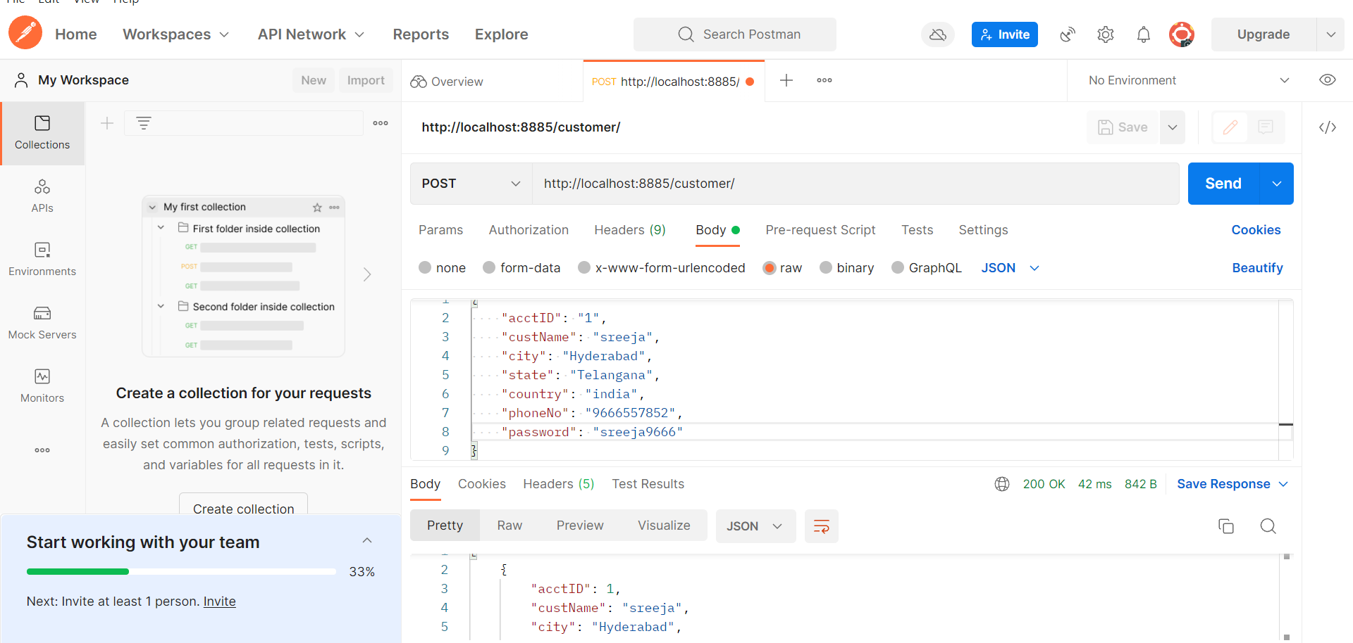
Inserting the customer values
URL:http://localhost:8885/customer/

Slide 11
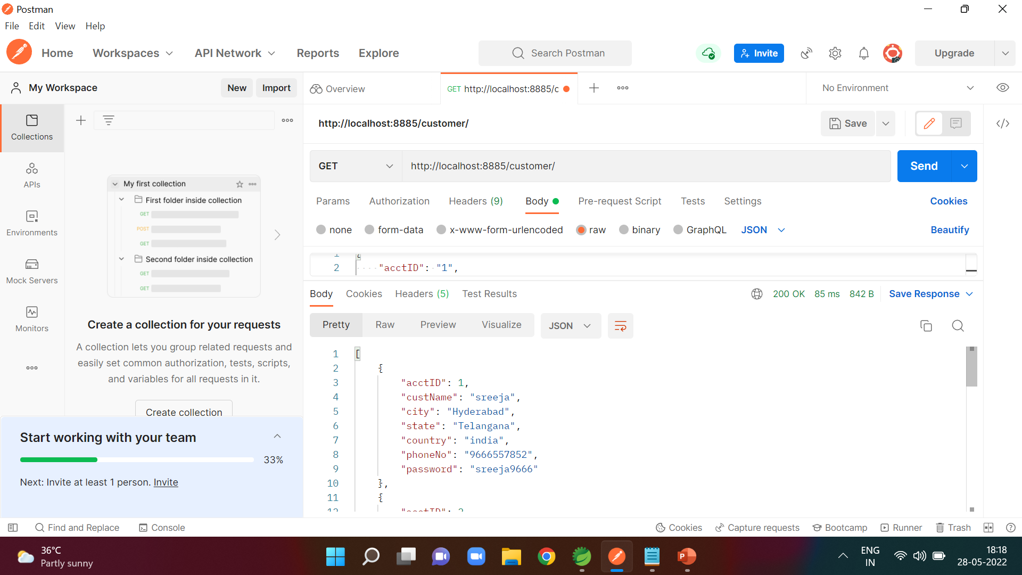
Display All details of Customer
URL:http://localhost:8885/customer/

Slide 12
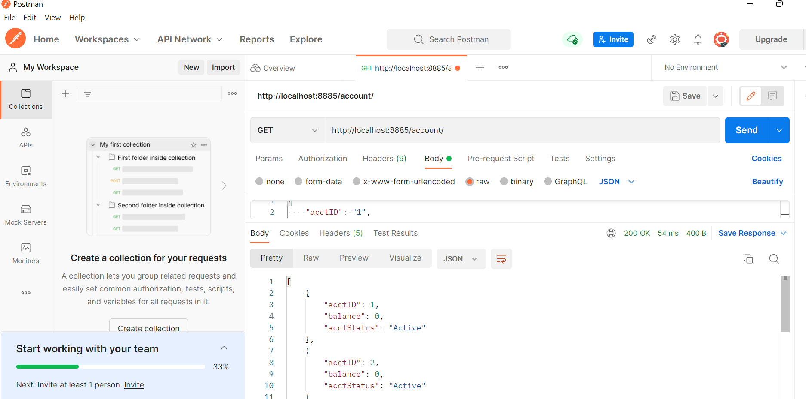
Display All details of Account
URL:http://localhost:8885/account/

Slide 13
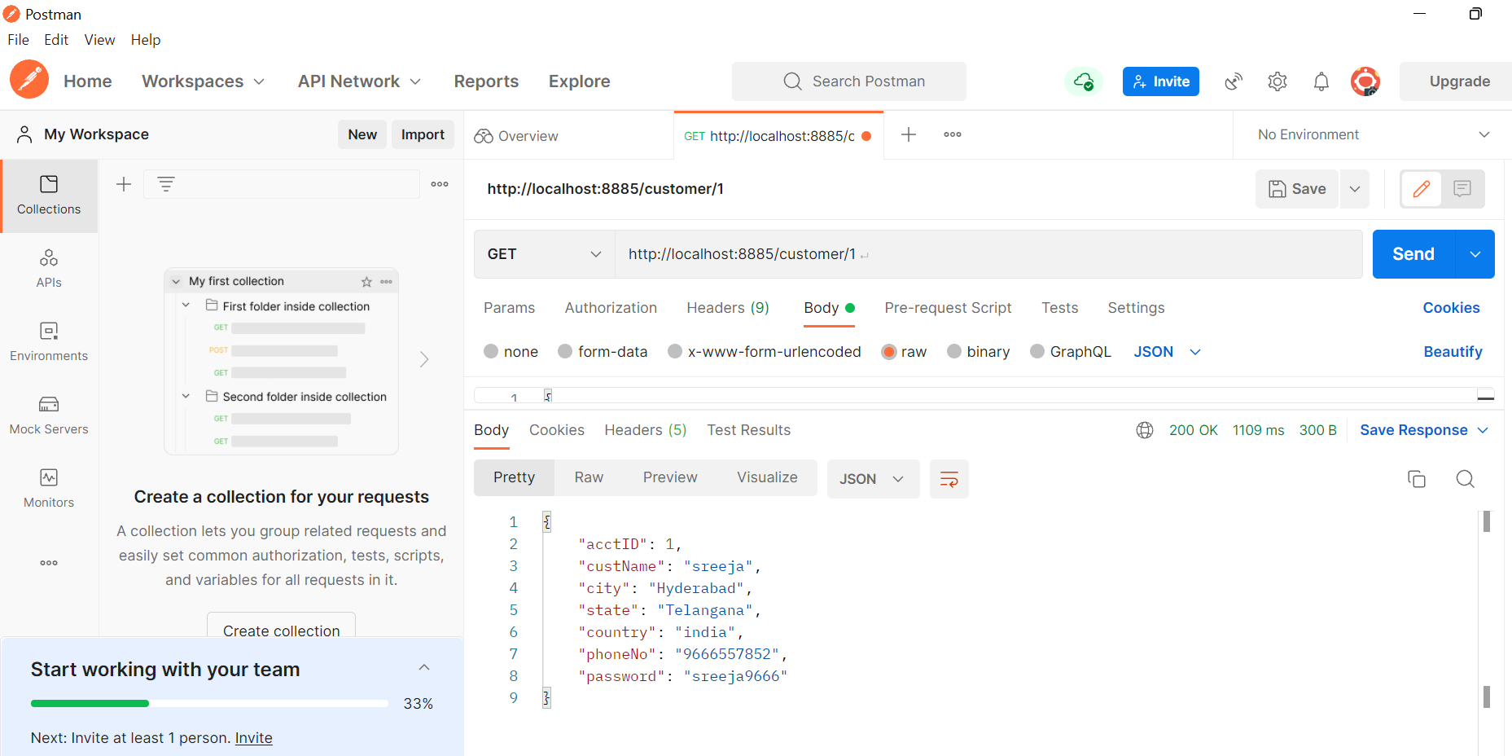
Display the details of customer based on id
URL:http://localhost:8885/account/1

Slide 14
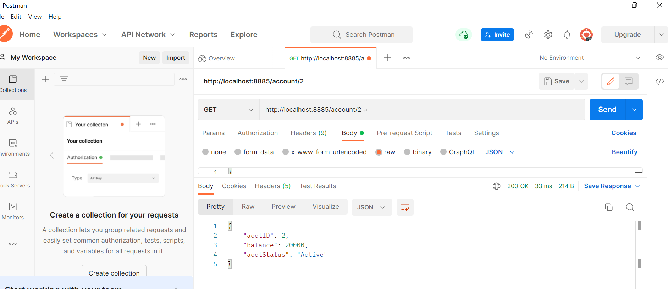
Display the details of customer Account based on id
URL:http://localhost:8885/account/2

Slide 15
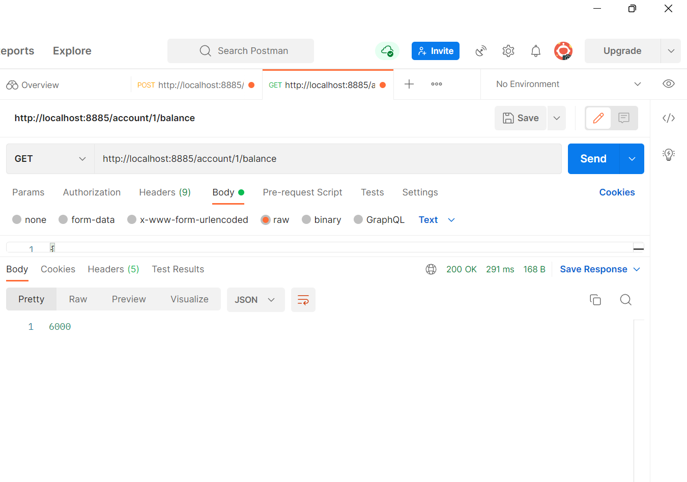
Display the balance of customer based on id
URL:http://localhost:8885/account/1/balance

Slide 16
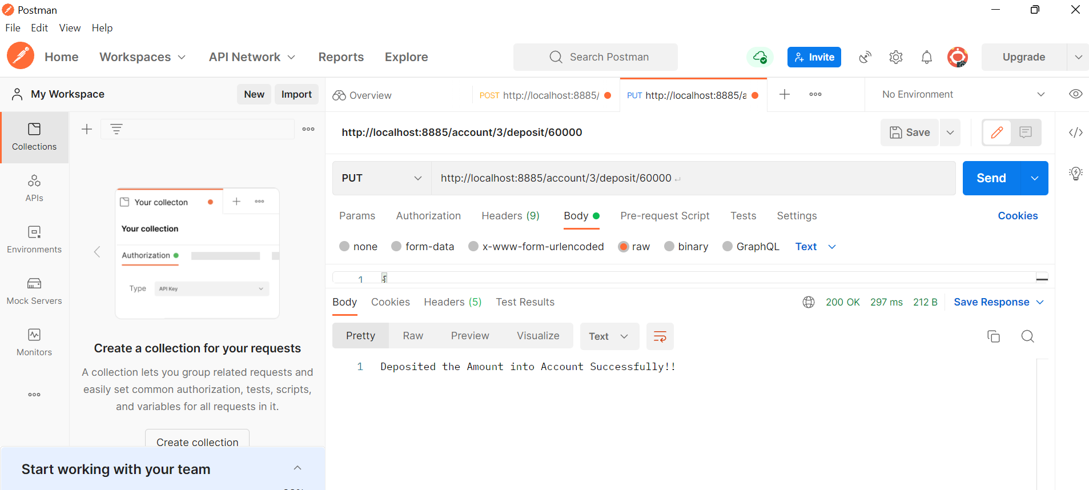
if Account Holder wants to Deposit some money into his Account
URL:http://localhost:8885/account/3/deposit/60000

Slide 17

if Account Holder wants to Withdraw some money into his Account
URL:http://localhost:8885/account/1/withdraw/5000

Slide 18
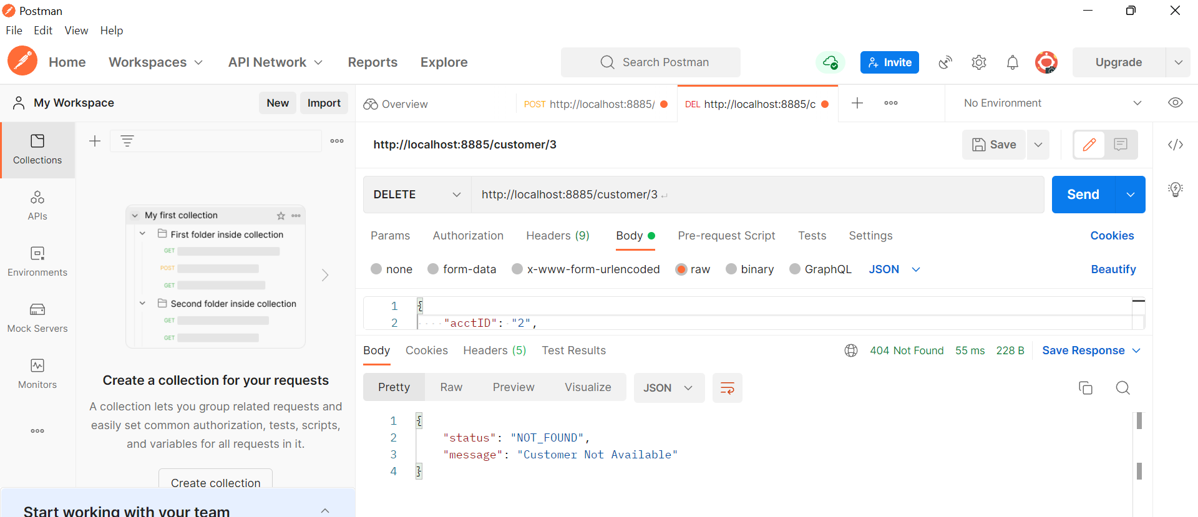
Deleting the customer details based on id
URL:http://localhost:8885/customer/3

Slide 19
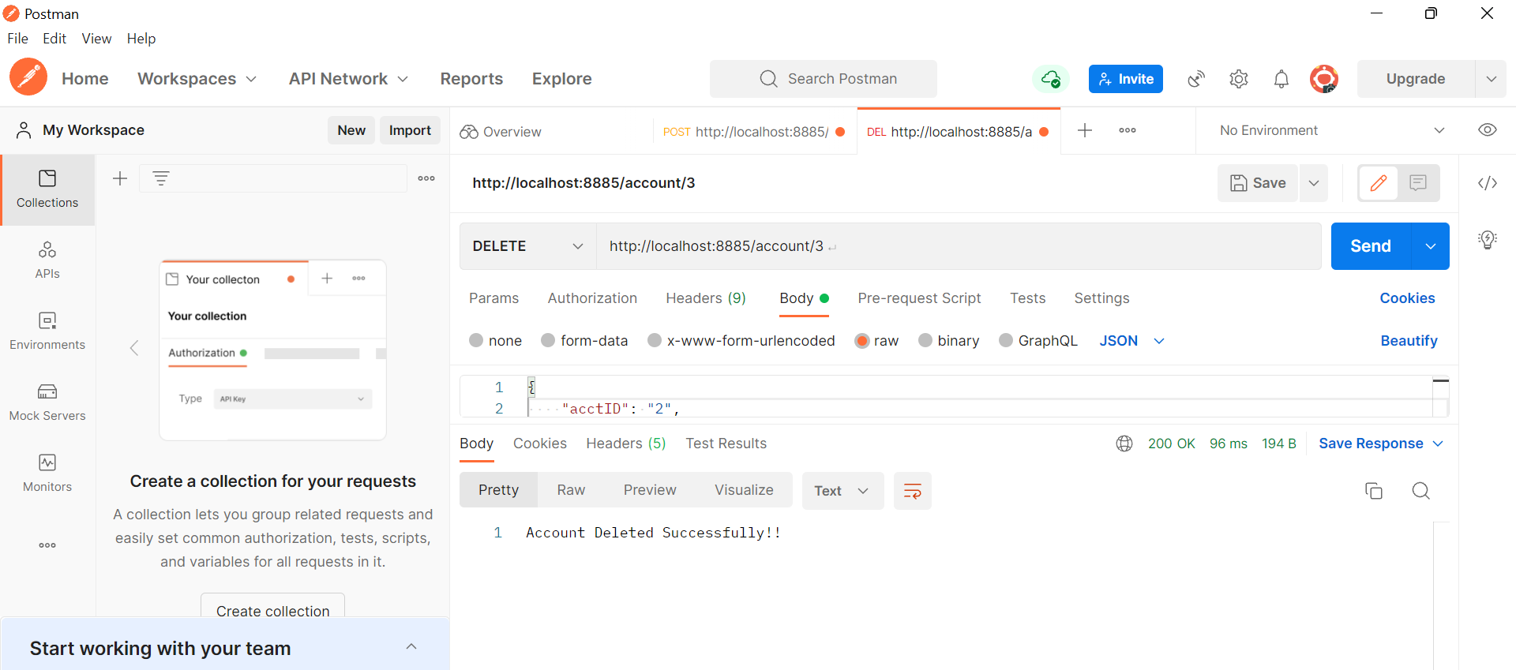
Deleting the account details based on id
URL:http://localhost:8889/account/3

Slide 20
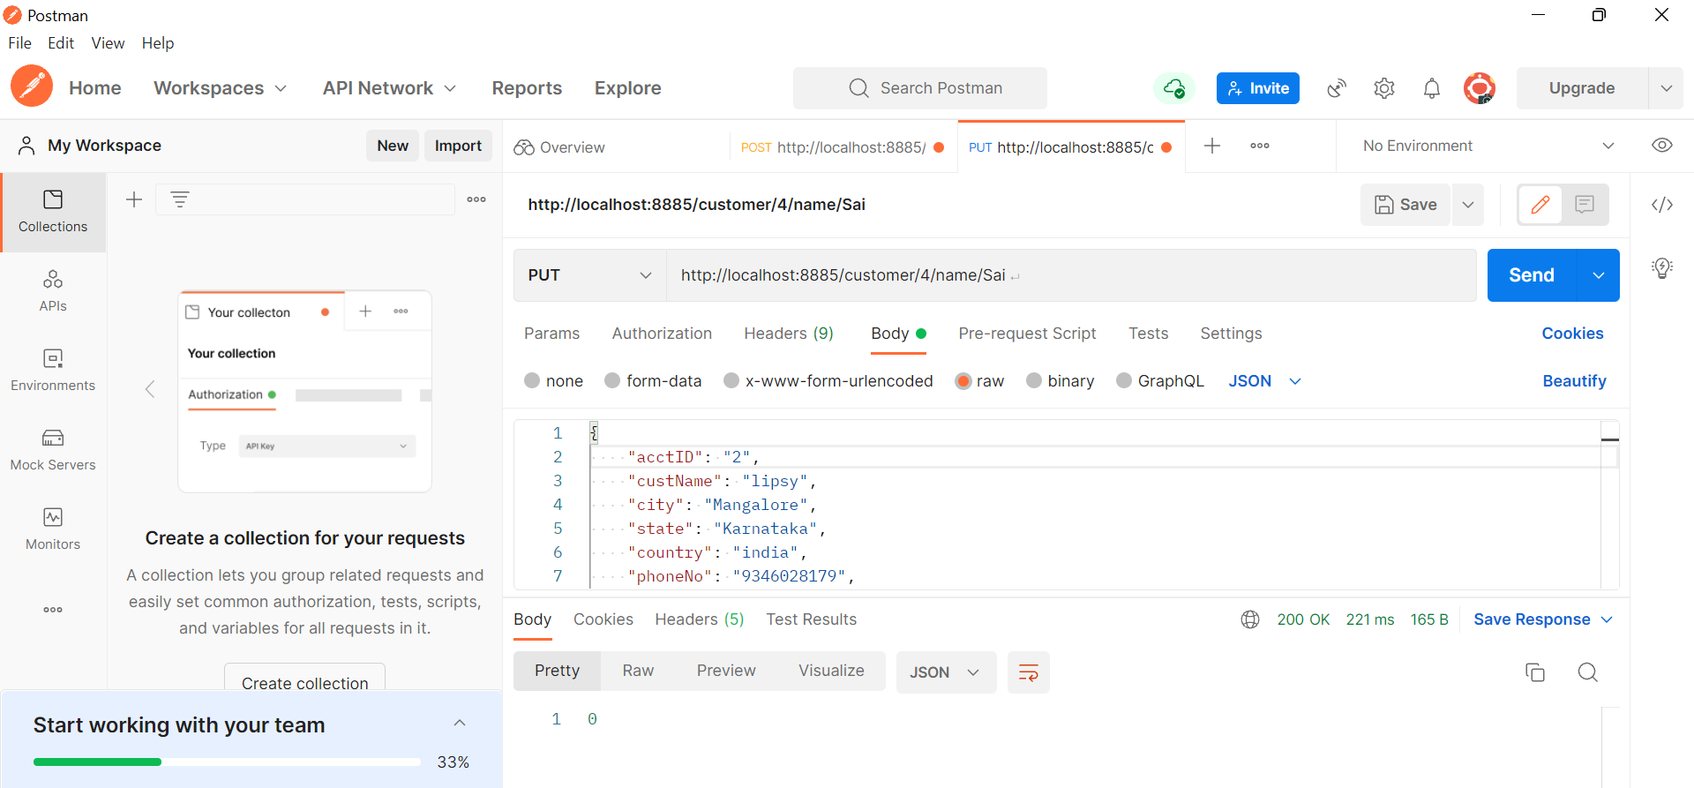
if Customer wants to Change His Name
URL:http://localhost:8885/customer/4/name/Sai

Slide 21
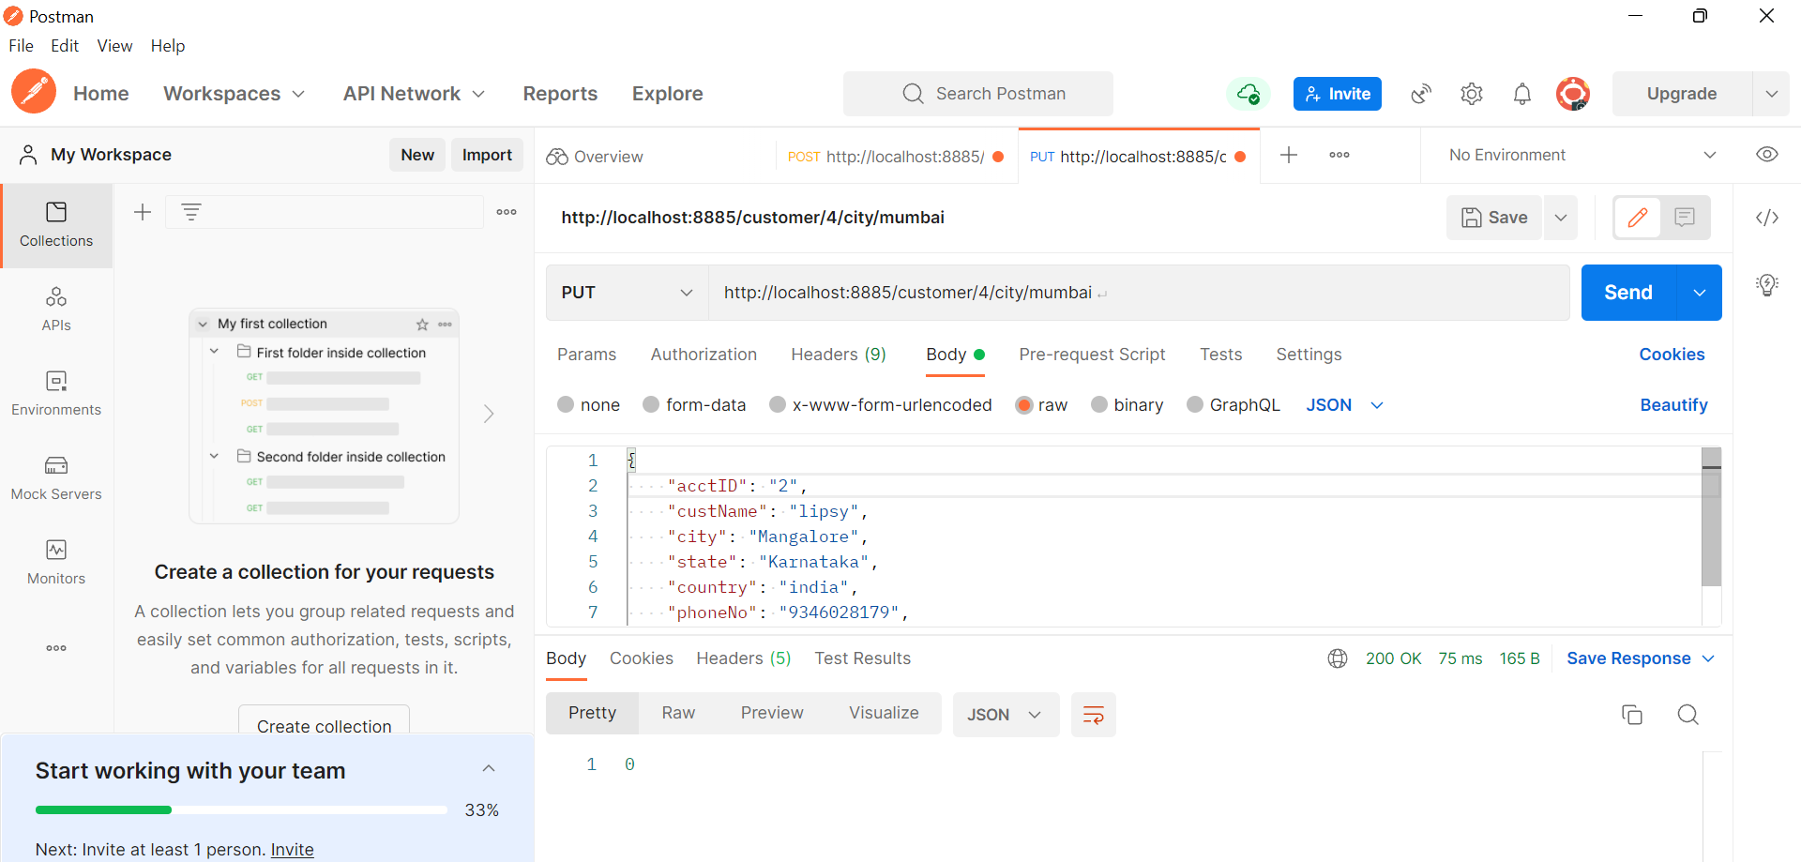
if Customer wants to Change His City
URL:http://localhost:8885/customer/4/city/mumbai

Slide 22
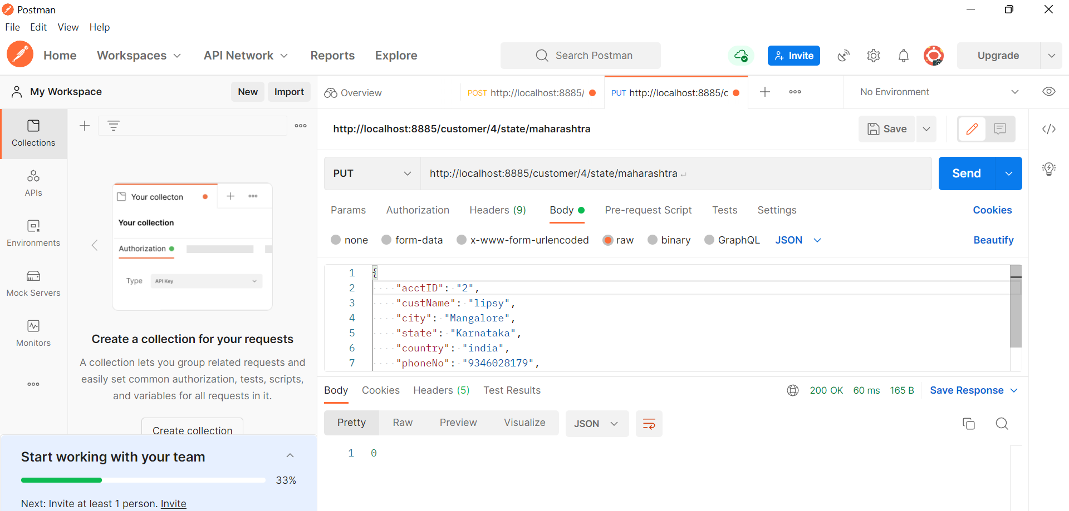
if Customer wants to Change His State
URL:http://localhost:8885/customer/4/state/maharashtra

Slide 23

if Customer wants to Change His Password
URL:http://localhost:8885/customer/4/password/sai9456

Slide 24
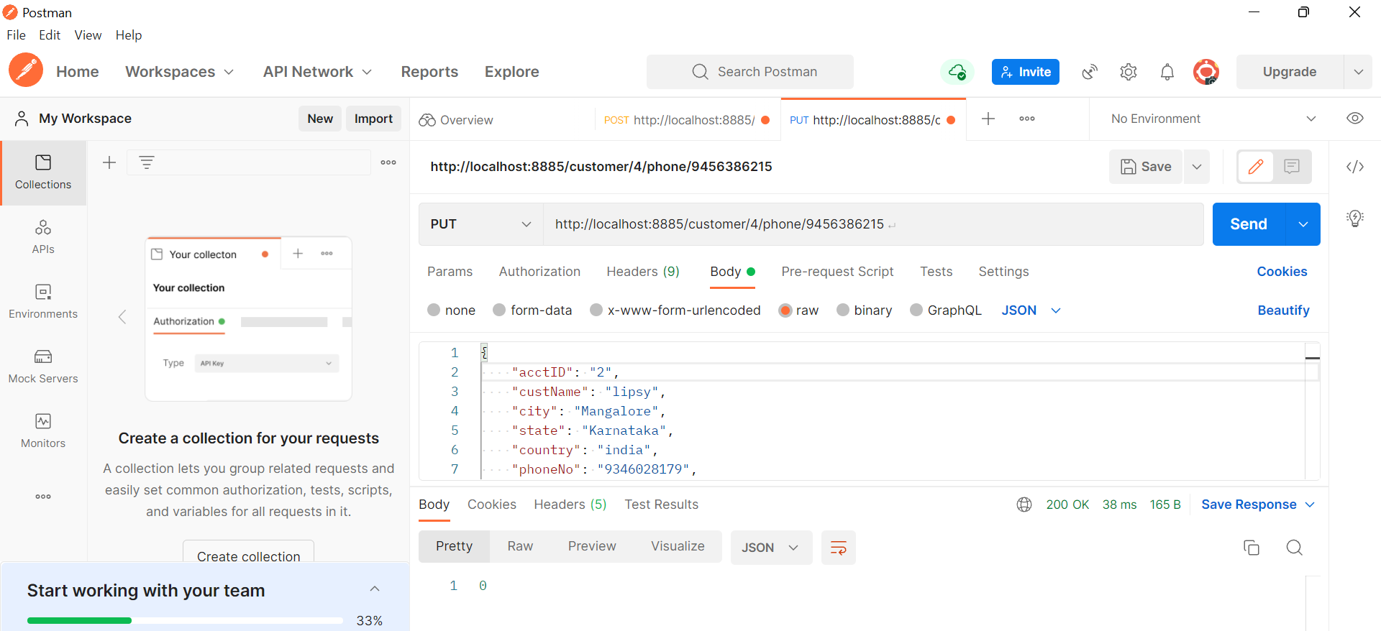
if Customer wants to Change His Phone Number
URL:http://localhost:8885/customer/4/phone/9456386215

Slide 25
Conclusion:
This project is developed to nurture the needs of a user in a banking sector by embedding all the tasks of transactions taking place in a bank.

Slide 26
Thank You

